Slide 1
Can we predict the next pandemic?
By: Itay Amini & Amos Alfasi

Slide 2

Our motivation
In the last year and a half, the whole world was, and still is, facing with an old-new challenge –
a worldwide pandemic.
Through out history, pandemics caused enormous damage ,so its important to predict the next ones, and be prepared.

Slide 3

Can we predict the chance of a virus to cause a worldwide pandemic using the data that is available on the web?

Slide 4

Our timeline
Finding data
Crawling
data cleansing
EDA
ML
Duplicates ,missing values & outliers handling
Search for sources of knowledge on the Internet
Scrape the data using a designated crawler
Data exploration and visualization
Train, Test and evaluate the results

Slide 5
01
Finding the data

Slide 6
Finding the data
It wasn’t an easy task to find the desirable data .
After days and nights of searching ,finally-we found it .
A Website called Spillover.
The Spillover is a national data base containing 887 different viruses. Each virus is ranked and gets his risk score based on 32 different risk factors. Risk factors are divided to 3 main groups: 'HOST', 'ENVIRONMENT' and 'VIRUS’.
Each risk factor also has a different contribution to the risk score: 'LOW', 'MEDIUM', 'HIGH’.
Spillover web page: https://spillover.global/ranking-comparison/
National Geographic's article about the spillover tool: https://www.nationalgeographic.com/science/article/can-a-new-app-predict-the-next-pandemic

Slide 7
02
Crawling

Slide 8

Crawling
We used crawling method to collect the data .
We tried to use ‘beautifulsoup’ library to scrape the data ,but Unfortunately without success .
Spillover is a Java script featured website, so in order to get the job done, we used Selenium.

Slide 9
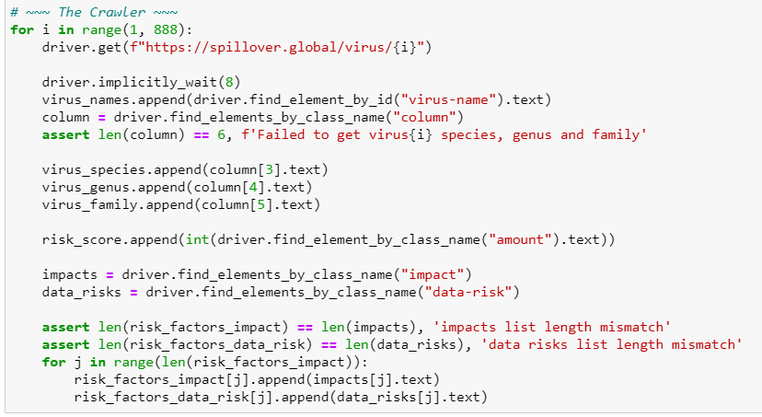
Crawling

Slide 10

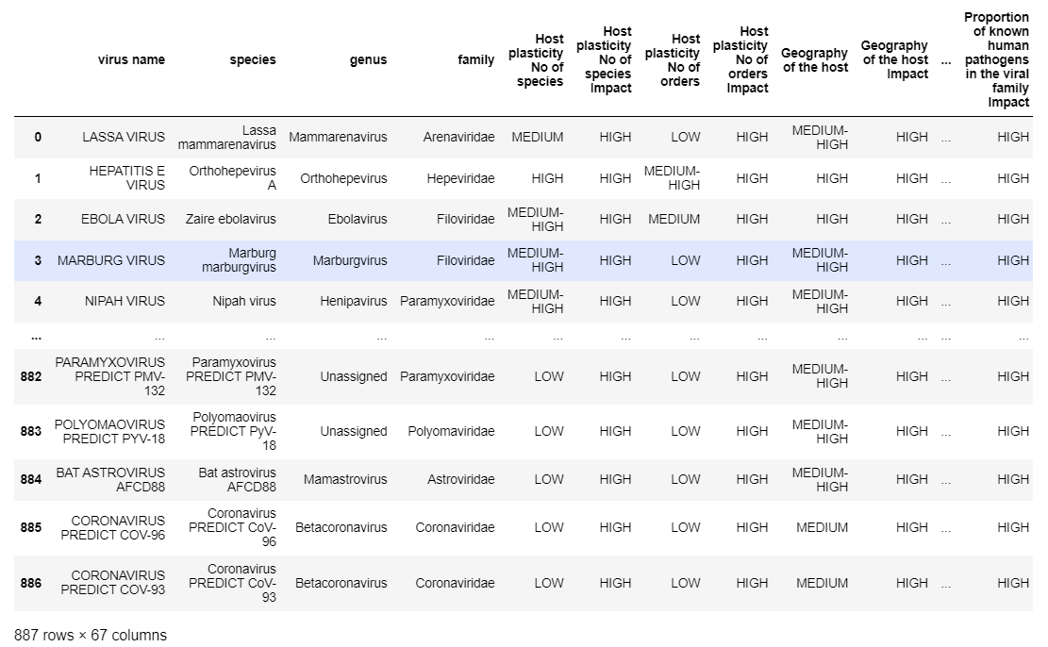
Crawling
The crawler iterate each virus’s full details page,
And In order to prevent server overload, we entered an implicit wait of 8 seconds between iterations.
The process took several hours.
Finally, we could build our full DataFrame.

Slide 11
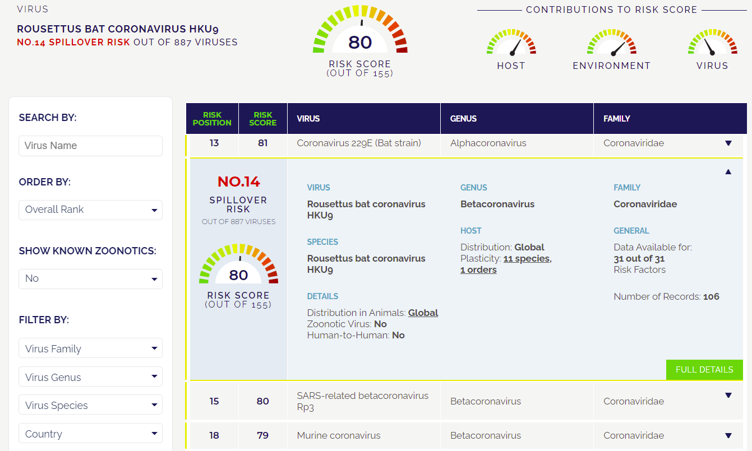
To this
From this

Slide 12
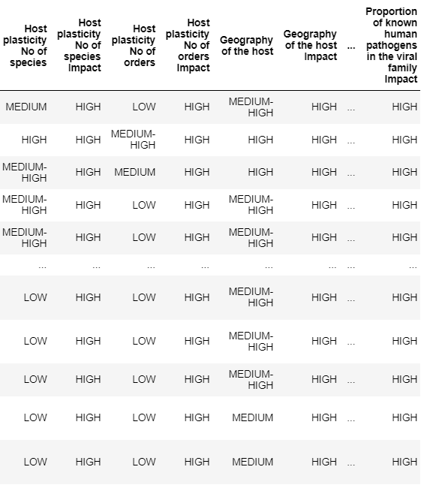
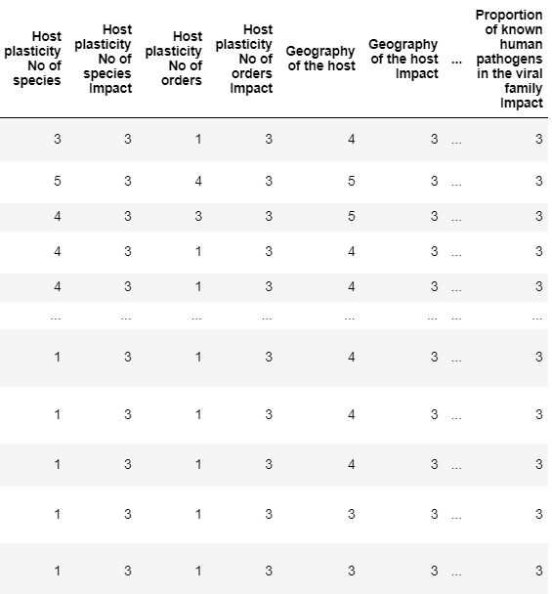
replacing the categorical values with numerical ones
No cases

Slide 13
03
Data Cleansing

Slide 14
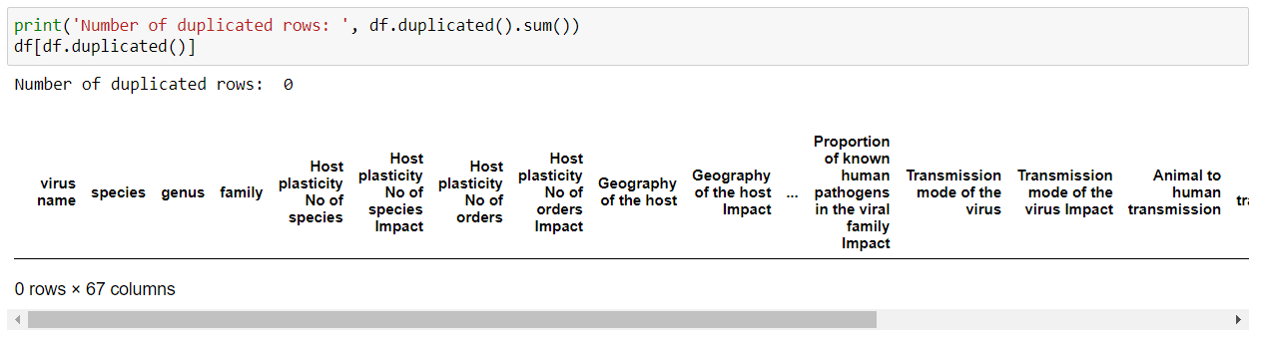
Duplicated Data
Our data frame doesn't have duplicates.

Slide 15
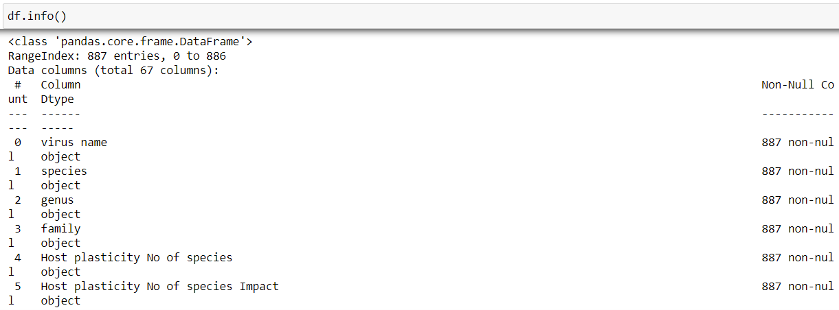
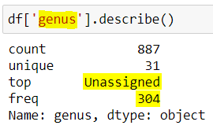
Missing values
Our data frame doesn't have missing values.
Although we don't have missing values, we found out that we have Unassigned values under 'genus' column.

Slide 16
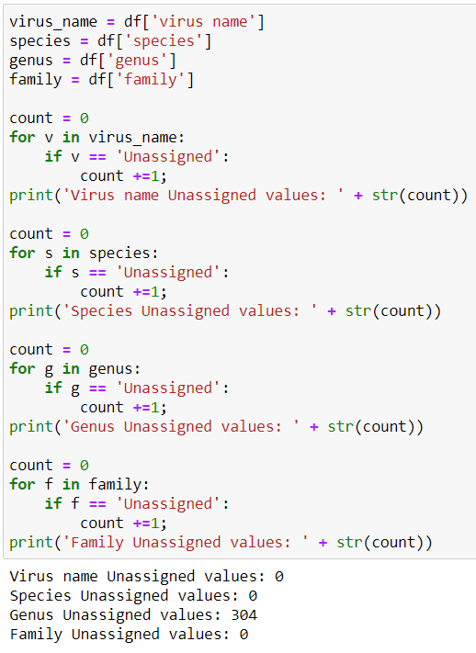
There are 304 Unassigned values under 'genus' column, we tried to count all Unassigned values for the following columns: 'virus name', 'species', 'genus', 'family’.
We didn't find any more Unassigned values, as for the 'Species' column's Unassigned values, We decided to leave it as it is.

Slide 17
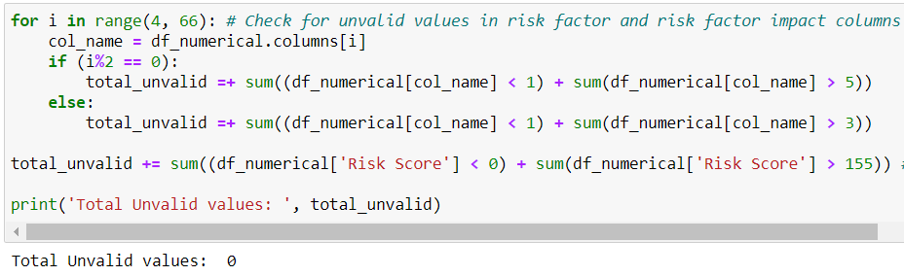
Outliers
In this part we will only verify that our numerical data frame column's values are valid and in range.
In our numerical data frame, every risk factor can get values between 1-5, Risk factor impact can get values between 1-3, And the risk score itself can get values between 0-155.
We will check if we have any data that goes outside of these limits.
All values are valid and in range.

Slide 18
04
EDA & Visualization

Slide 19
Know your Data
About our data
Our dataset contains the following information for 887 different viruses:
Name, species, genus, family, risk score, and 31 different risk factors each with different
impact on the risk score(risk factors are divied into 3 main groups: HOST, ENVIRONMENT and VIRUS).
An explicit detail of each risk factor (And its impact on the total score) could be found in our Jupiter
Notebook or in the Spillover website.
Reported cases
No cases

Slide 20
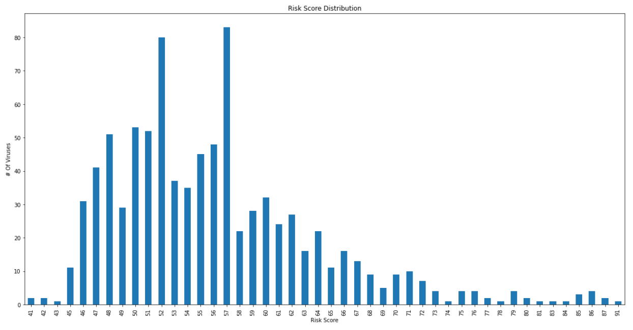
Risk Scores Distribution Bar Graph
We can see that risk scores varies between 41~91, and that most of viruses are ranked below risk factor of 65 and are concentrated on the left side of the scale.

Slide 21
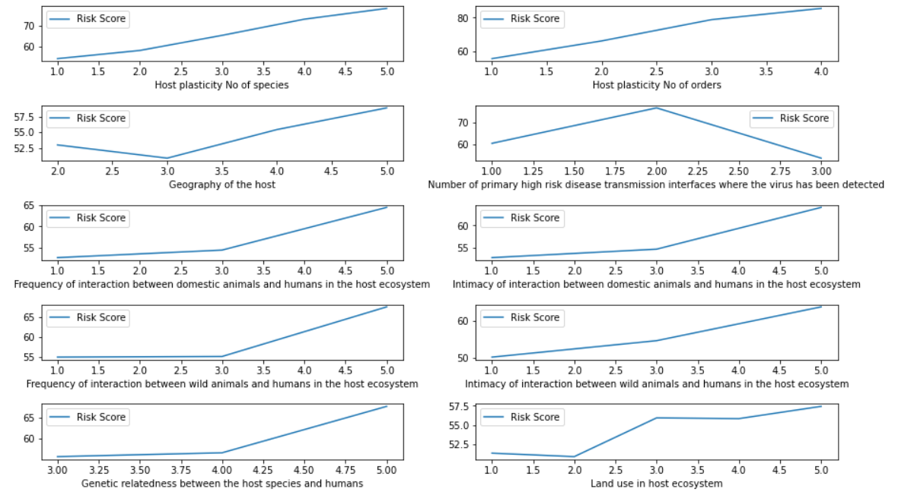
Risk factors VS Risk Scores - Line Graphs
In this section we would like to see the impact of different risk factors on the virus's risk score.
For every given risk factor, we grouped by its possible values and calculated a mean values data frame, from this data frame we took the 'Risk Score' column series and displayed it on a graph.
More graphs can be found in our Jupiter notebook..

Slide 22
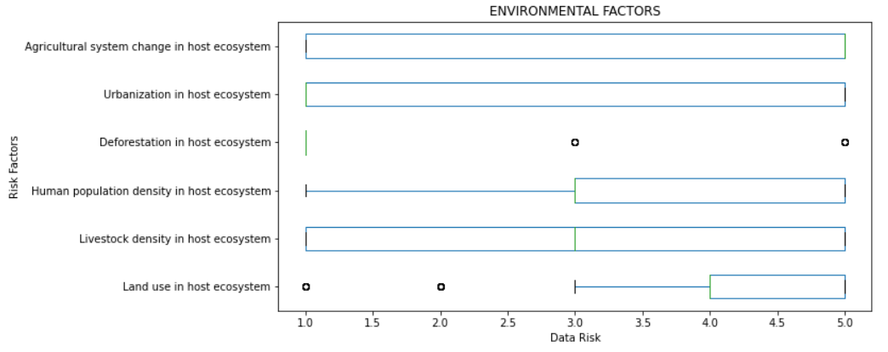
Risk Factors Distribution - Box Plots
In this section we will see the data risk distribution of all viruses per risk factor using box plots.
The risk factors are divied into 3 main groups: HOST, ENVIRONMENT and VIRUS
More graphs can be found in our Jupiter notebook..

Slide 23
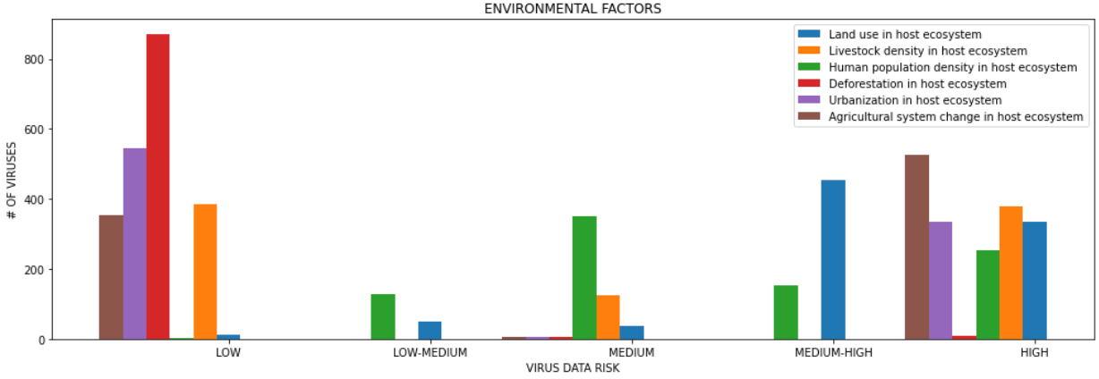
Risk factors distribution - Bar graphs
In the next few bar graphs, we will go trough groups of risk factors, and see how our virus's data base divides.
We will see the count of viruses which are rated: 'LOW', 'LOW-MEDIUM', 'MEDIUM', 'MEDIUM-HIGH', 'HIGH' per risk factor.
More graphs can be found in our Jupiter notebook..

Slide 24
05
Machine Learning

Slide 25
In this part we will try to solve a regression problem: Predict virus's risk score based on his risk factor parameters. We will use supervised machine learning algorithm, train and test it on our dataset, finally we will evaluate the results.

Slide 26
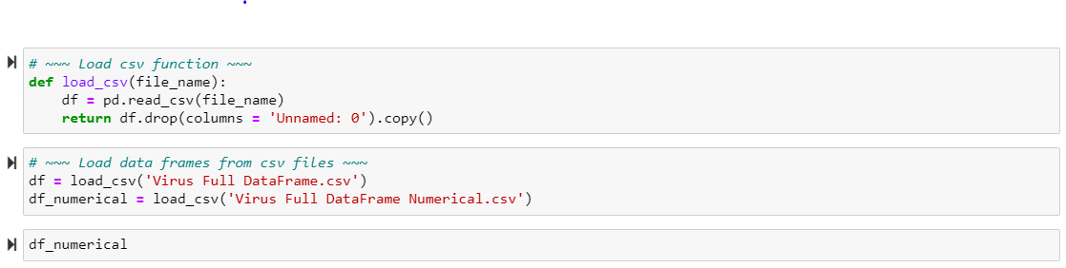
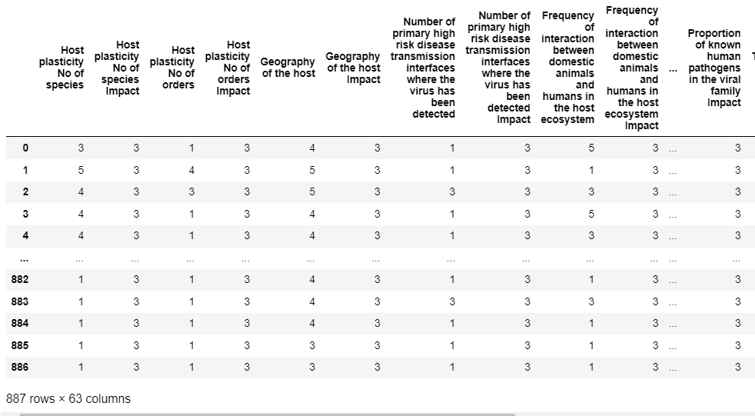
First ,we will remove the unnecessary columns ('virus name', 'species', 'genus' and 'family’)
Leaving us with a numerical data frame:

Slide 27


Next, we will Define 2 new functions: 1) split the dataset 2) Create a trained model

Slide 28
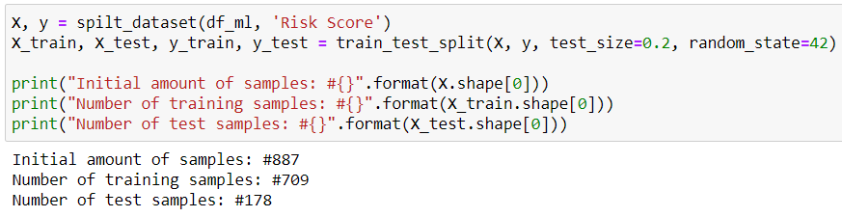

Next-time for training
Split the data – 80% train set & 20% test set
Training a model and craeting predictions for the test set

Slide 29
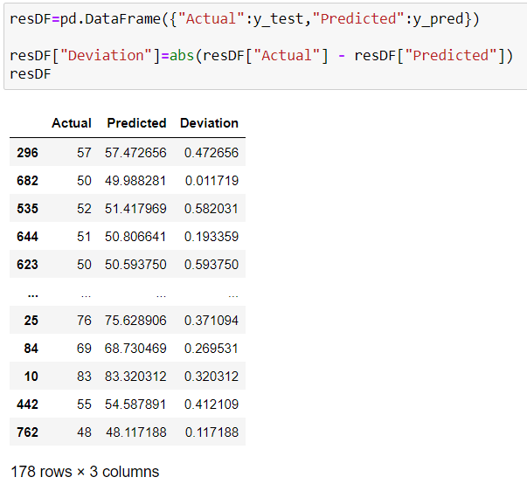

Results
The results were very accurate.
We can see that the largest deviation between the actual values to our model's predicted values is relatively small.

Slide 30
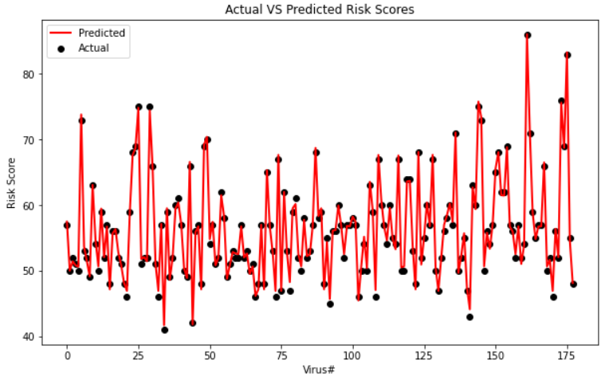
Actual VS Predicted Risk Scores

Slide 31

R2 Score Test – Model Performance Evaluation
We have got a result very close to 1, Which indicates a very high level of prediction accuracy of our model (1 Meaning a perfect prediction).

Slide 32
In conclusion
Almost every day new viruses are discovered, some are harmful, and some may be a big threat on our society.
Based on our test results it looks like we can predict very accurately the risk scores of new viruses, which can help determine the probability of a virus to be implicated in pandemic or epidemic/outbreak events in humans or animals..
it was a grate experience and a lot of fun to create such a project and harness the power of machine learning for the greater good.

Slide 33


THANKS!
We hope you enjoyed
Stay safe
GitHub

